Slide 1


Drupal & AI | May 21, 2025
Ollama: Using Open-source AI for Drupal Development
Rich Lawson
Associate Director of Technology at Evolving Web
linkedin.com/in/rich-lawson
evolvingweb.com

Slide 2

Agenda
Open-source AI
Drupal AI
Ollama
Continue
The Future
Questions
Notes:
Anna

Slide 3





















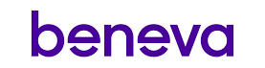








Bringing digital experiences to life
Higher Ed
Healthcare
Full-service agency specializing in Drupal
Platinum Certified Drupal Partner
Part of the Drupal CMS leadership team
5,000+ Drupalists trained since 2011
Organizers of EvolveDrupal event series
Culture & Tourism
Transit & Infra
Financial
Government
Notes:
And I’ll also introduce Evolving Web. We’re a full-service digital agency that specializes in Drupal. We also run a training program and organize an event series called EvolveDrupal. And we work with world-class organizations and public institutions.

Slide 4
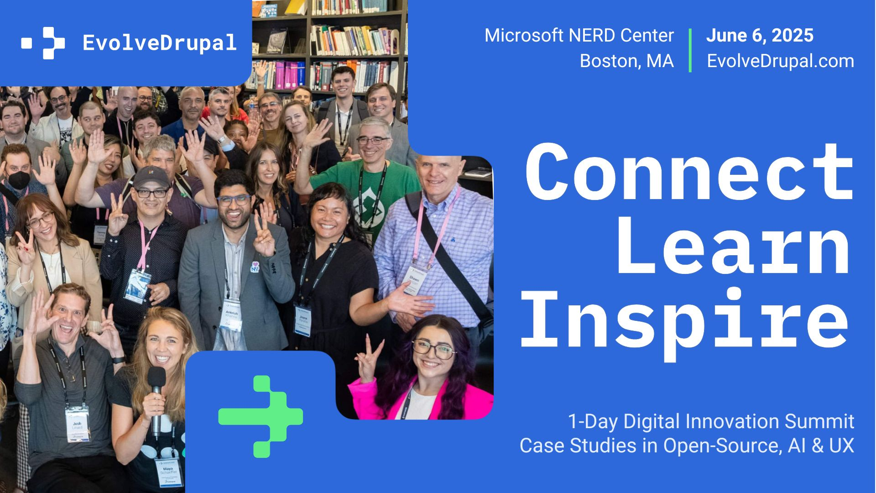

Slide 5

Open-source AI
01
Notes:
Placeholder, should add new title slide to match the other section slides

Slide 6

What is Open-source AI?
OPEN-SOURCE AI
An Open Source AI is an AI system made available under terms and in a way that grant the freedoms to:
Use the system for any purpose and without having to ask for permission.
Study how the system works and inspect its components.
Modify the system for any purpose, including to change its output.
Share the system for others to use with or without modifications, for any purpose.
These freedoms apply both to a fully functional system and to discrete elements of a system. A precondition to exercising these freedoms is to have access to the preferred form to make modifications to the system.
https://opensource.org/ai/open-source-ai-definition
Notes:
We’re used to working with Drupal, which is open-source software, which makes it great for contributions and working with the community.
But what about when you apply “open source” to AI?
There’s more complexity.
The Open Source Initiative (OSI) spent two years researching open-source AI with AI experts from various fields and then led a global co-design initiative to come up with this definition, which was published in October 2024.
Ever since, they’ve been gathering endorsements.
The key to open-source with this definition is being able to use the AI for whatever you would like without having to ask anyone for permission.
You should also be able to study how the system works, including components, such as how the training code works and even review the training data.
With Open Source AI, you should also be able to change the system however you want, for any purposes.
Finally, you should be able to share that system with others.

Slide 7
More about open-source AI
OPEN-SOURCE AI
Other definitions: “Embracing the Future of AI with Open Source and Open Science Models” on the The Linux Foundation site
Other proposals: The Model Openness Framework, Cornell University
Is it really open source?
Some LLMs that claim to be open restrict access to things like code, training data, or commercial usage.
Example: The Llama 3 license, which has additional commercial terms requiring a license from Meta if an application hits 700 million+ monthly active users and has restrictions in terms of improving other LLMs.
Notes:
It’s beyond the scope of this talk a little bit, but I did want to mention that there are others working on open source definitions and other proposals for AI.
There is some debate about whether or not models that claim to be open source really are open source.
Make sure to review licenses for any models you work with for a project.
You will not use the Llama Materials or any output or results of the Llama Materials to improve any other large language model (excluding Meta Llama 3 or derivative works thereof).
If you use the Llama Materials to create, train, fine tune, or otherwise improve an AI model, which is distributed or made available, you shall also include “Llama 3” at the beginning of any such AI model name.

Slide 8

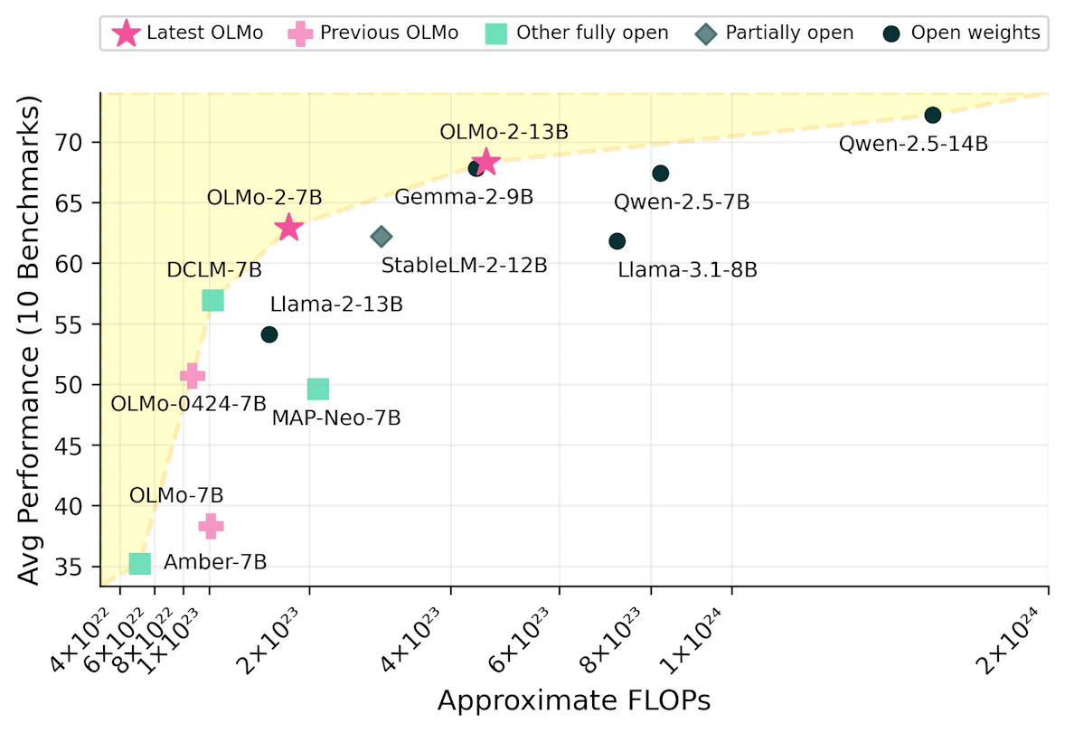
Fully open models
OPEN-SOURCE AI
OLMo 2, which can be run with Ollama.
It is fully open, with:
Open and accessible training data
Open-source training code
Reproducible training recipes
Transparent evaluations
https://allenai.org/blog/olmo2
Notes:
FLOPs
FLoating-point Operations Per Second, which measures the number of floating-point calculations per second.
Make sure to review licenses for any models you work with for a project.

Slide 9
Why should we care?
OPEN-SOURCE AI
Isn’t it easier to pay a small fee and enter a token?
Advantages | Disadvantages
Transparency Privacy Community & collaboration Customization capabilities Democratization Cost | Expertise requirements IP limitations for models used commercially Resource requirements Quality Cost
Notes:
Almost all of these have caveats
Cost is in both columns

Slide 10


Drupal AI
02
Notes:
Now that we’ve talked a little bit about the definition, pros and cons, and questions that surround it, let’s talk about using AI in Drupal.

Slide 11

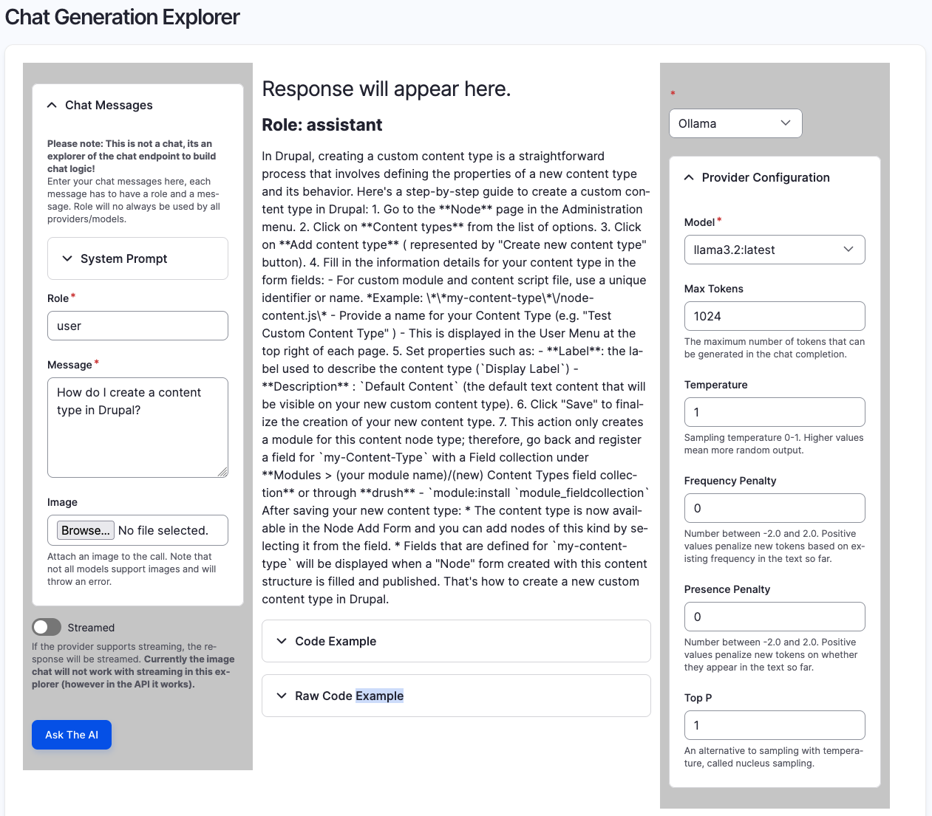
Drupal’s AI capabilities
DRUPAL AI
AI module: https://www.drupal.org/project/ai
AI Explorer: Tool to test your prompts.
AI Automators: Automatically populate or update fields in Drupal. It integrates with ECA. Check out Marcus Johansson's talk during DrupalCon Atlanta on this topic.
AI Search, while experimental, integrates with Search API. There was a Pierre Marcel's talk at EvolveDrupal Toronto 2024 focused on this.
Providers
There are more than 20 different providers that can be used with Drupal via the Provider modules, including Ollama.
Notes:
There were a lot of AI modules in Drupal, but there has been a lot of recent consolidation.
During the DriesNote at DrupalCon Atlanta in late March, Dries pointed out how Drupal is often leading the way in the CMS space in terms of AI.
AI Automators: Use case to look at text and extract addresses to automatically populate an address field.
AI Search: Use an Embedding model plus a vector database like Pinecone to build out your own search. Using Umami recipe site as an example, display tacos when someone searches for Mexican food even if there is no taxonomy that defines that and no examples of the word “Mexican” in the recipe itself.
Embedding models are algorithms that translate data (e.g., text and images) into numerical representations (vectors) that capture semantic relationships and patterns.
Providers: Open AI and Gemini, as well as platforms like Azure and AWS Bedrock.

Slide 12

Drupal’s growing AI ecosystem
DRUPAL AI
Module & recipe ecosystem
Agents
Image alt text
Summarize document (for PDFs)
Translations
SEO
Image (for generation)
Media Image (for generation directly into the media library)
Notes:
Agents: Help you with site building in Drupal, which can be great for learning.
Image alt text: We’ll talk more about this, but it can help editors make their imagery accessible.
Translations: We did a webinar on this recently. There are great ways to add automated translations to a Drupal site that can also be worked into your workflow.
For example, do you want translations to be automatically generated as soon as content is added or edited? What about human editorial review?
SEO: Baked into Drupal CMS with CKEditor to look for issues.
Image: Generate images in CKEditor with Stable Diffusion and others

Slide 13


Ollama
03
Notes:
Now that we’ve talked a little bit about Drupal’s AI capabilities, how can we used Ollama to run open-source AI LLMs locally?

Slide 14


What is Ollama?
OLLAMA
Open-source platform through which users can work with and run large language models (LLMs) locally
Developed at startup of the same name that was founded in 2023
Focuses on ease of use and privacy
Provides a model library with popular LLMs and can support others
Notes:
Startup: One thing that can be a little confusing is that Meta created Lllama LLMs, but Ollama is independent.

Slide 15
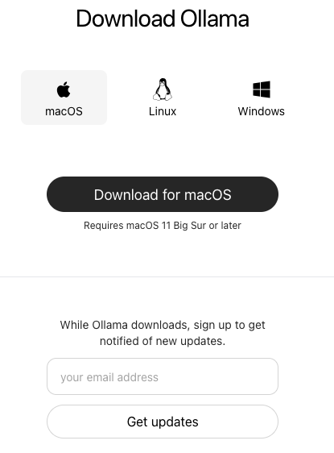
Installing Ollama
OLLAMA
My preferred option is with Homebrew: https://brew.sh/
brew install ollama
Another option: https://ollama.com/download
Provides an installer for macOS, Linux, and Windows
Still needs to be run through the terminal
Quickstart:
ollama run llama2

Slide 16
Running Ollama: Most used commands
OLLAMA
Command | Description | Example usage
ollama | List available commands | N/A
ollama pull | Pull a model from a registry | ollama pull qwen2.5-coder:1.5b-base ollama pull llama3.2-vision
ollama run | Run a model | ollama run qwen2.5-coder:1.5b-base ollama run llama3.2-vision
ollama list | List models | N/A
ollama ps | List running models | N/A
ollama rm | Remove a model | ollama rm qwen2.5-coder:1.5b-base ollama rm llama3.2-vision

Slide 17
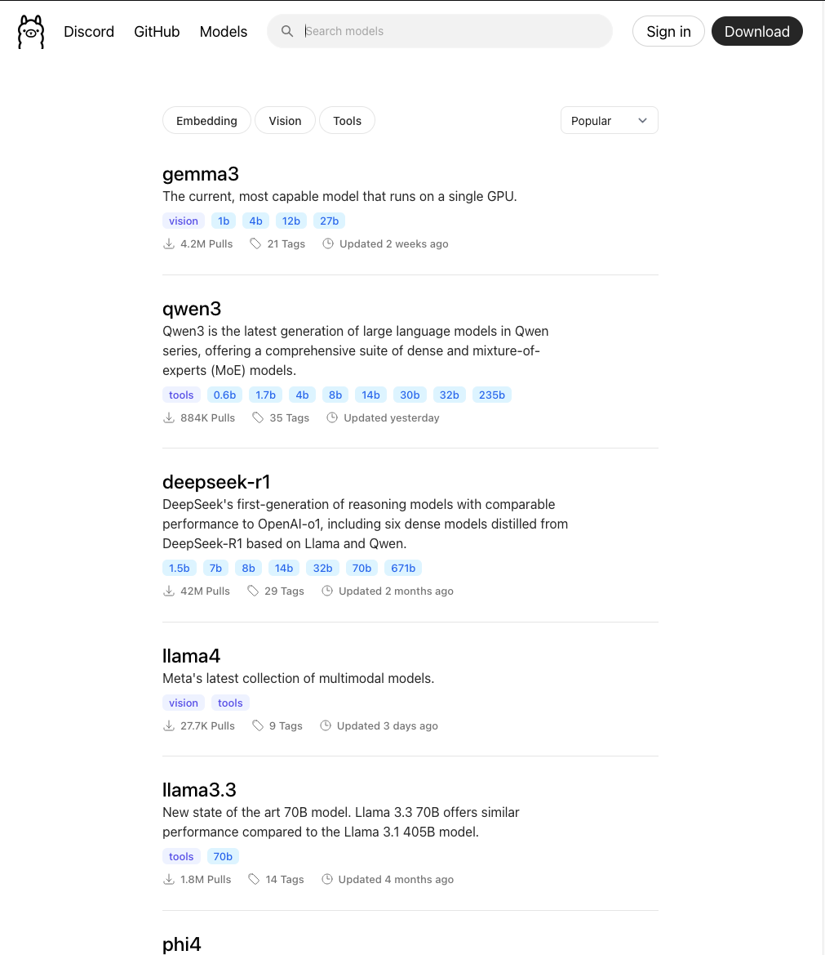
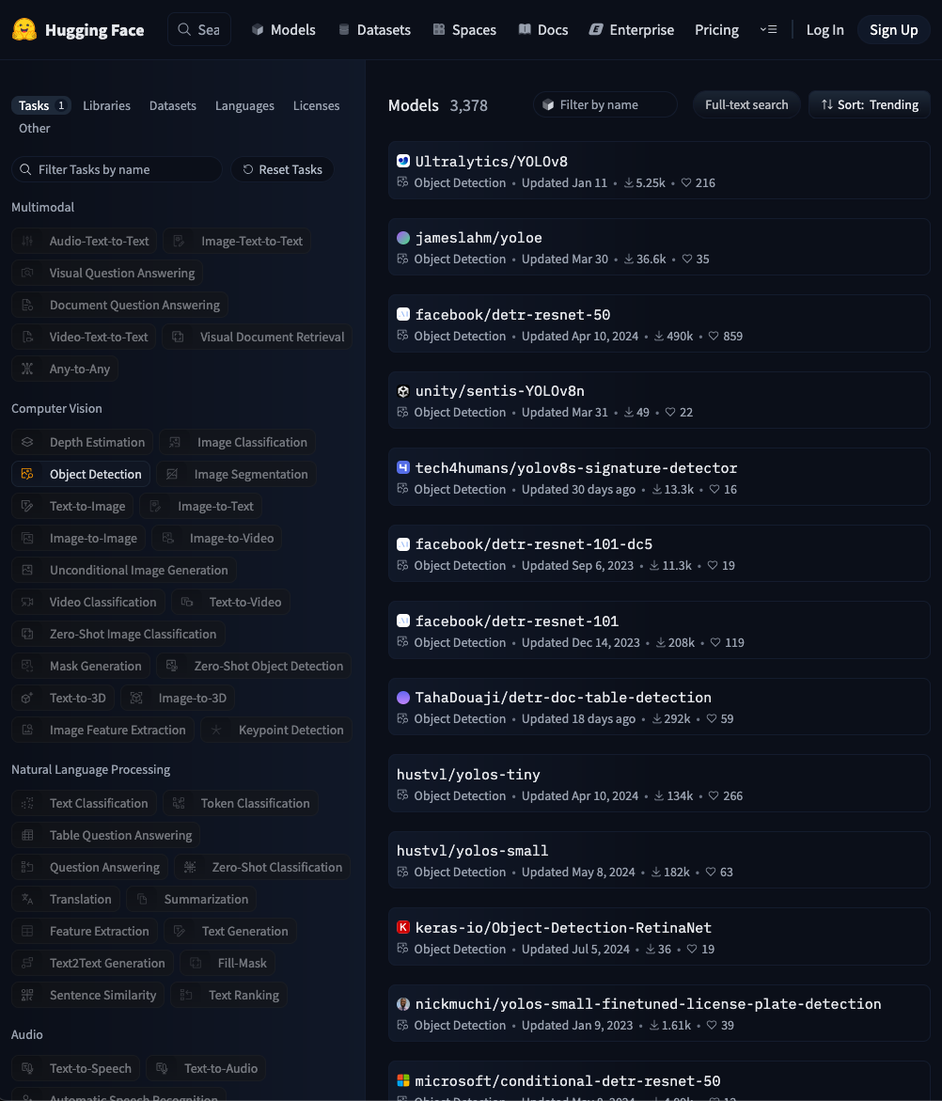
Finding models for Ollama
OLLAMA
ollama.com/search
Simple interface
Hugging Face
Dive deeper into specific types of models
Find models based using a wide variety of filters:
Tasks (Object-Detection, Image-Text-to-Text)
Libraries (GGUF, TensorFlow)
Datasets (nvidia/HelpSteer, intel/orca_dpo-pairs)
Languages (English, French)
Licenses (apache-2.0)
More
Notes:
Hugging Face
Collaboration platform for the AI community to focus on models, datasets, and applications.
Enables you to find a variety of different models that can be specialized around specific needs.
GGUF
GTP-Generated Unified Format (GGUF) for the deployment and use of LLMs.
Hugging Face tasks:
Multimodal Audio-Text-to-Text, Image-Text-to-Text
Computer Vision Object-Detection, Video-Classification
Natural Language Processing Question Answering, Summarization
Audio Text-to-Speech, Automatic Speech Recognition
More

Slide 18
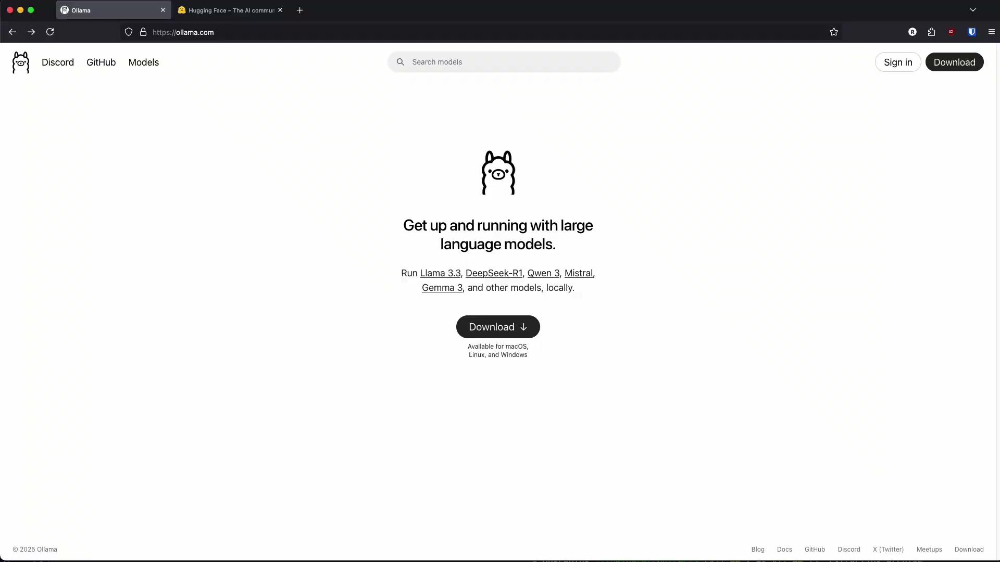
Finding models
OLLAMA

Slide 19
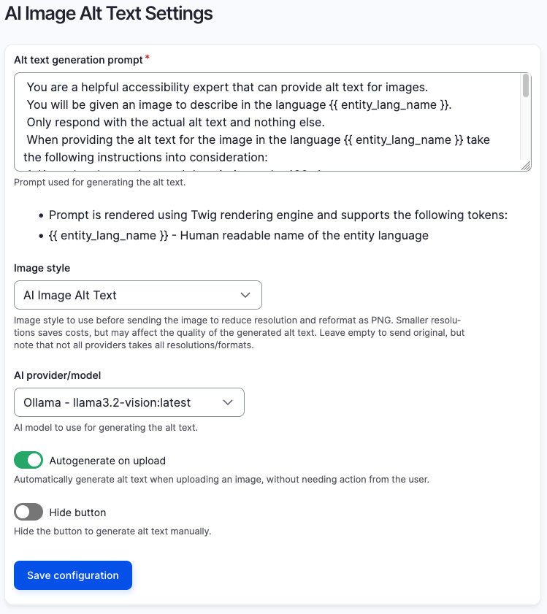
Drupal CMS AI Image Alt Text
OLLAMA
Update to dev version of AI module: composer require 'drupal/ai:1.0.x-dev@dev'
Install Drupal AI Ollama Provider module: composer require 'drupal/ai_provider_ollama:1.0.x-dev@dev'
Enable and configure the Ollama Provider module: /admin/config/ai/providers/ollama
Enable and configure the AI Image Alt Text module: /admin/config/ai/ai_image_alt_text
Test it out by uploading an image to the media library: /media/add/image
Notes:
Start with Drupal CMS.

Slide 20
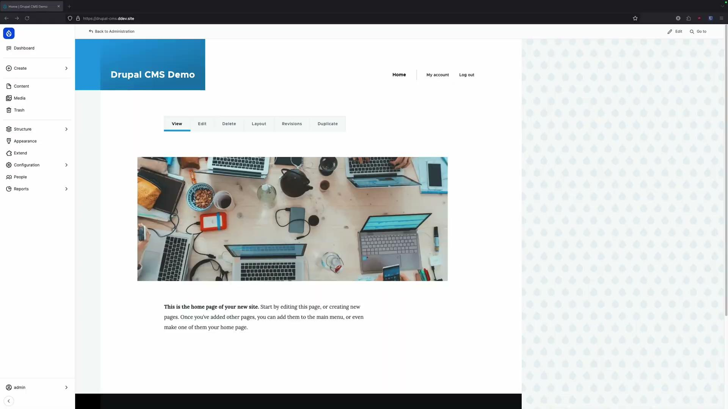

Slide 21
Local vs. production
OLLAMA
Ollama is not a production tool, so you’ll need something else to run open-source models in production.
Run open-source AI in production using tools like:
amazee.io
AWS Bedrock
Azure AI Foundry
Google Cloud Run
Beam.cloud
vLLM EC2, on-prem, etc.
Notes:
Full disclosure, I haven’t run open-source LLMs in production yet, but it’s okay, since it’s beyond the scope of this presentation.

Slide 22


Continue
04
Notes:
Placeholder, should add new title slide to match the other section slides

Slide 23


What is Continue?
CONTINUE
https://continue.dev
Integrated Development Environment (IDE) extension
Open-source
Devs can create, share, and use custom AI code assistants
Typical IDEs used for Drupal development, such as VS Code and PHPStorm
Main capabilities
Chat: Ask for help from an LLM without leaving the IDE
Autocomplete: As you type, Continue provides inline code suggestions from your selected LLM
Edit: Modify your code without leaving the current file
Agent: Equipped with the ability to solve a wide range of coding tasks

Slide 24
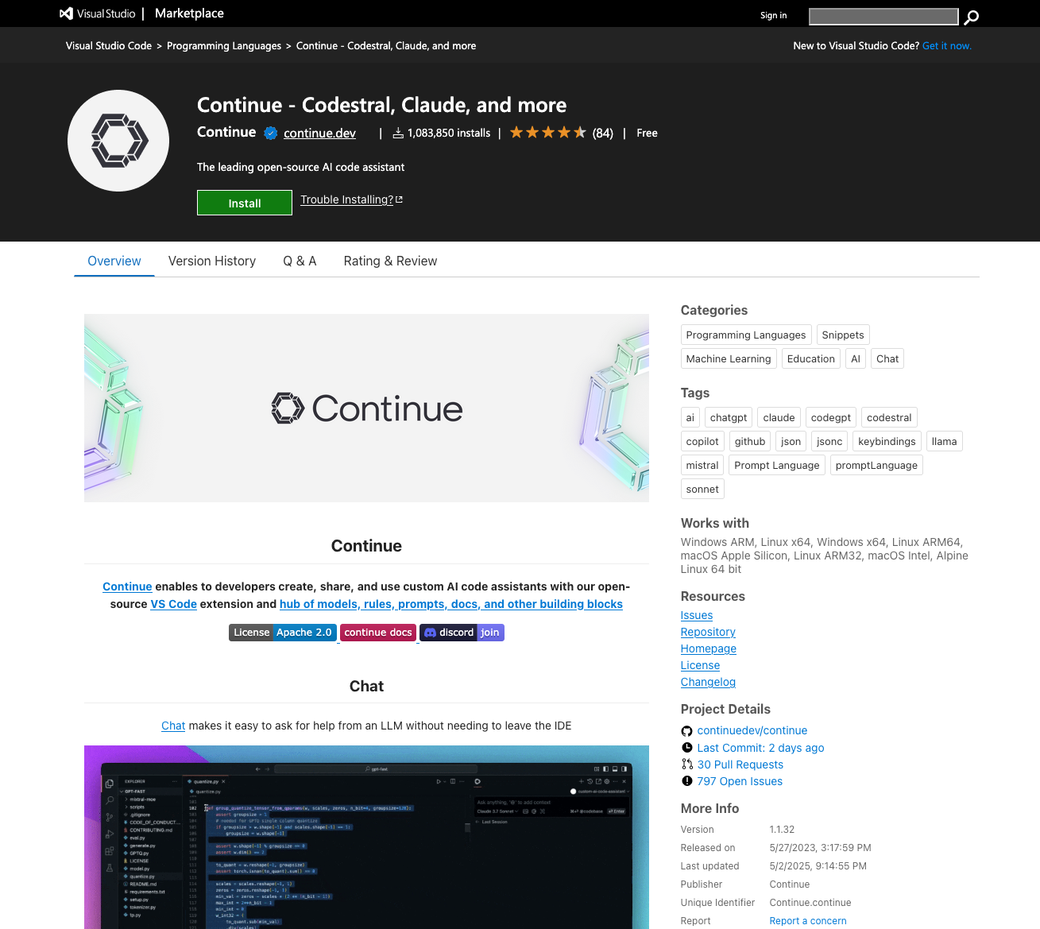
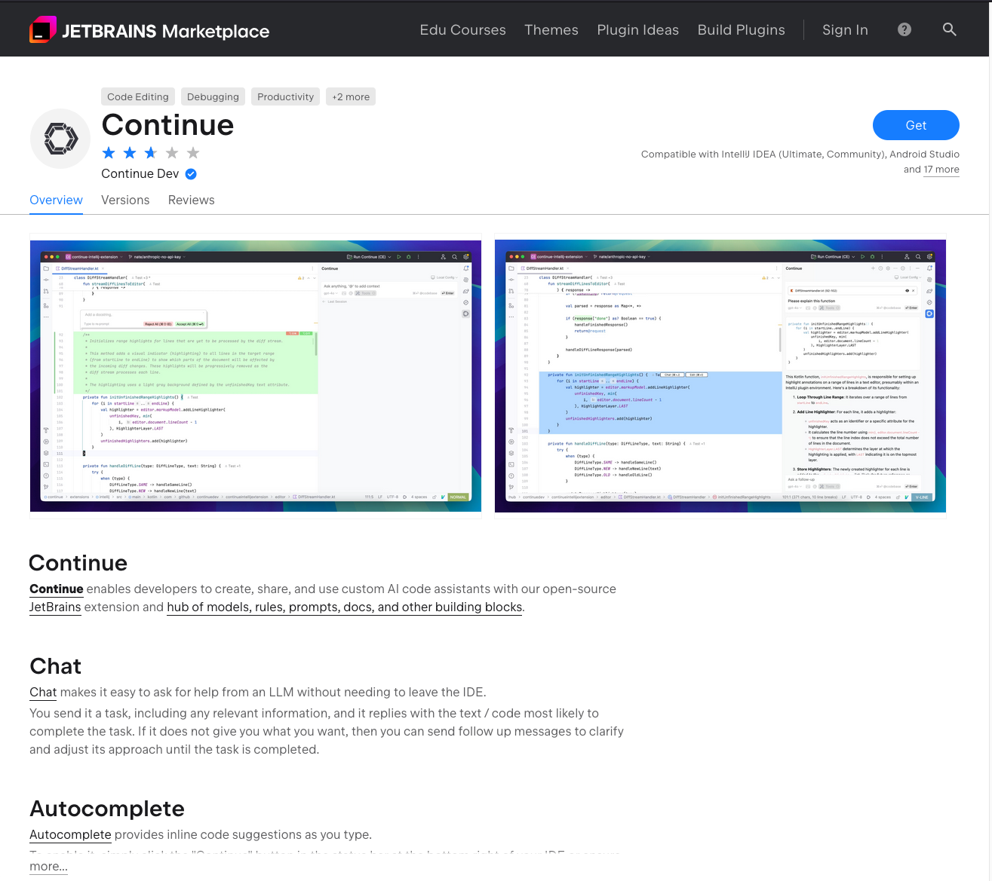
Installation
CONTINUE
Continue has a VS Code Extension and JetBrains plugin, so it’s easy to install:

Slide 25
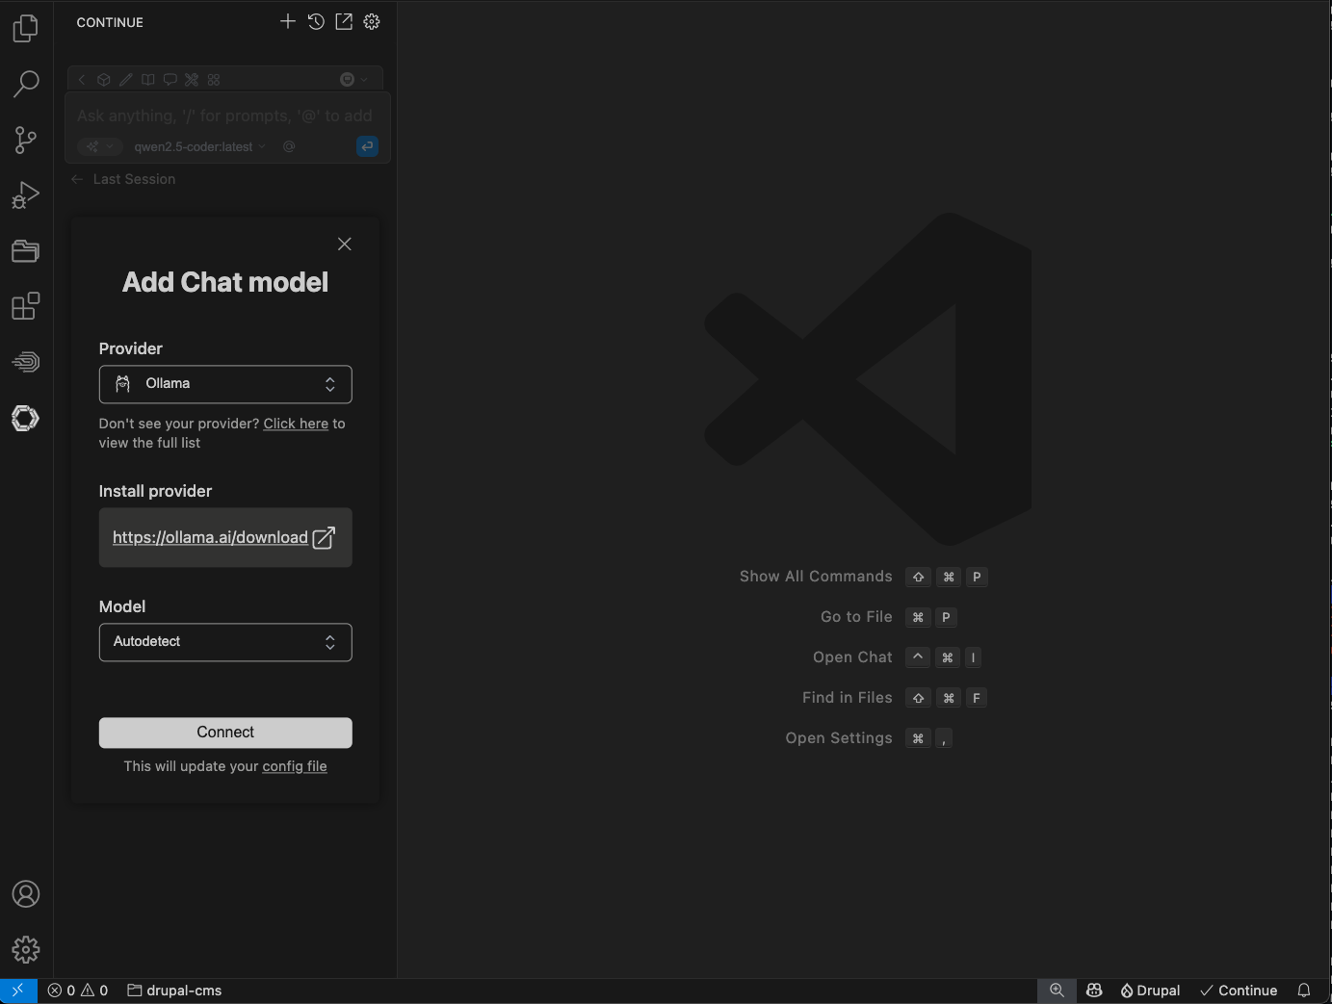
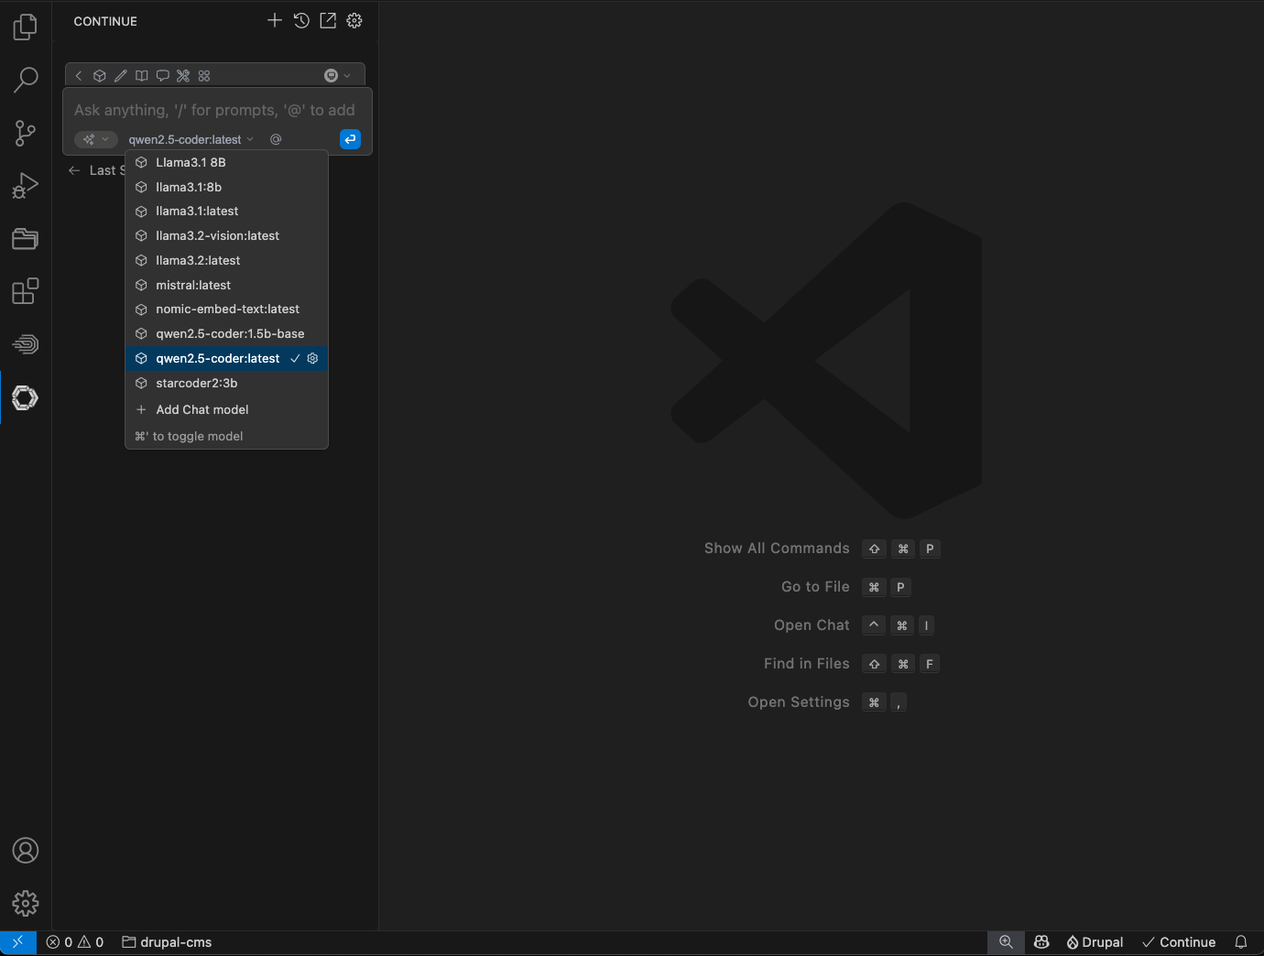
Installation: Ollama
CONTINUE
Add Chat model in Continue:

Slide 26
Cursor demo: Assistant apply

Slide 27
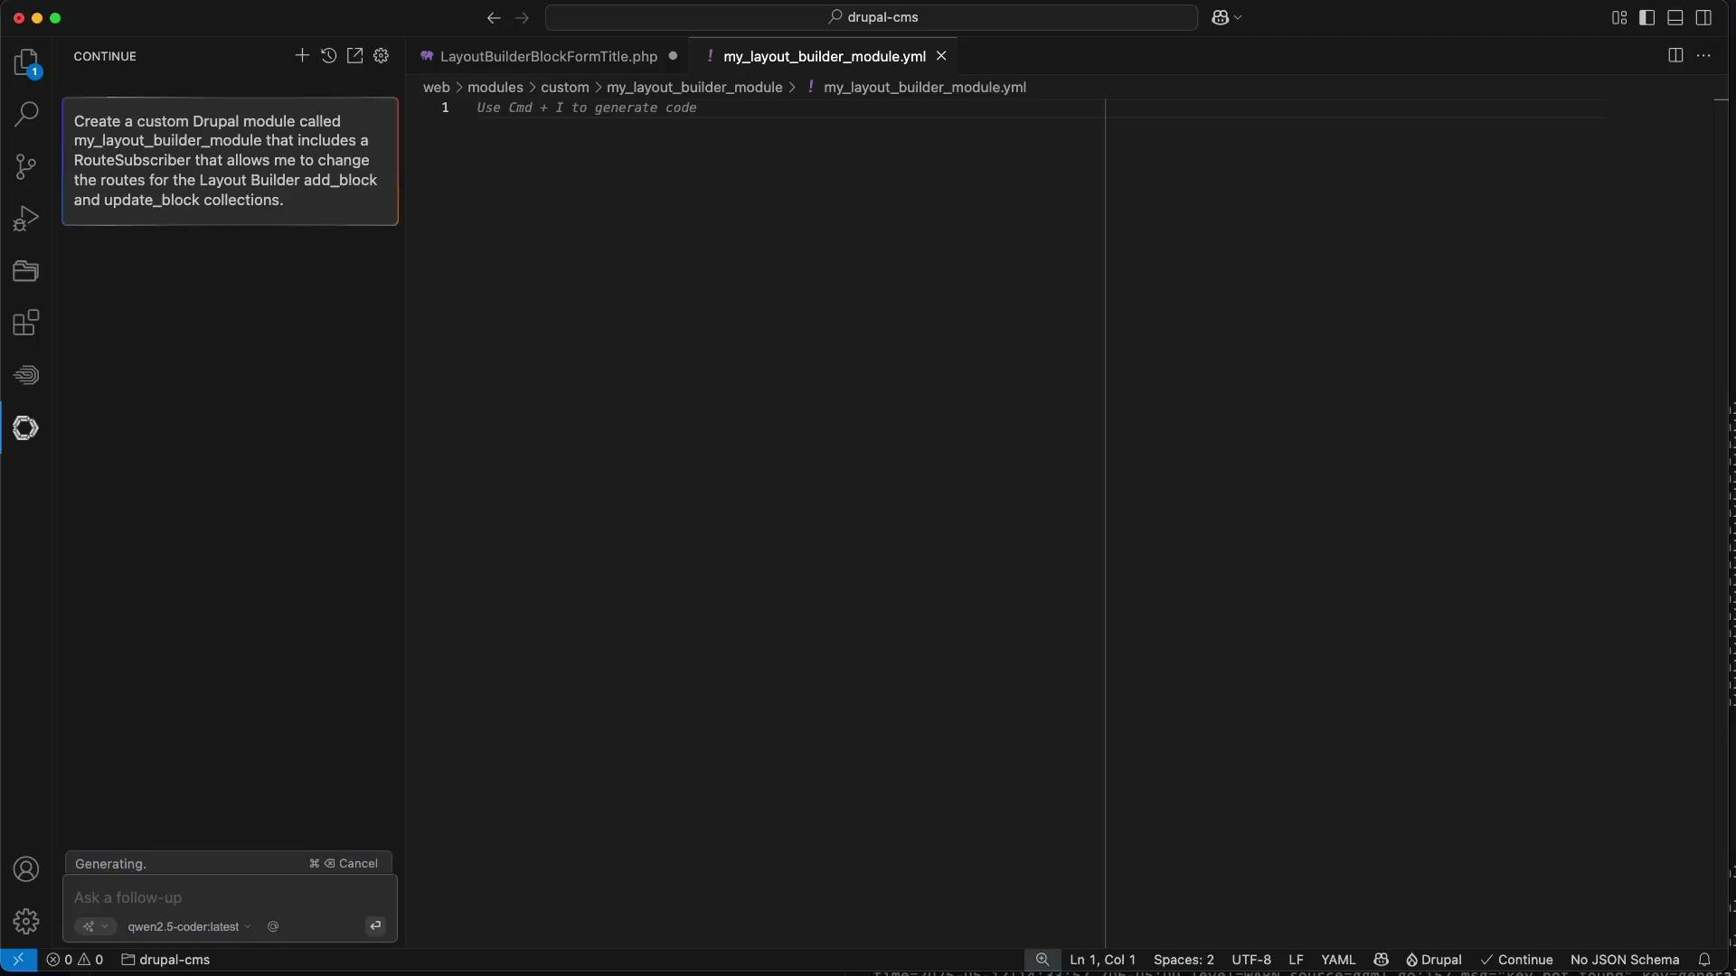
Demo: Assistant apply
CONTINUE
Notes:
Demo: Assistant apply

Slide 28
Cursor demo: Code commenting

Slide 29
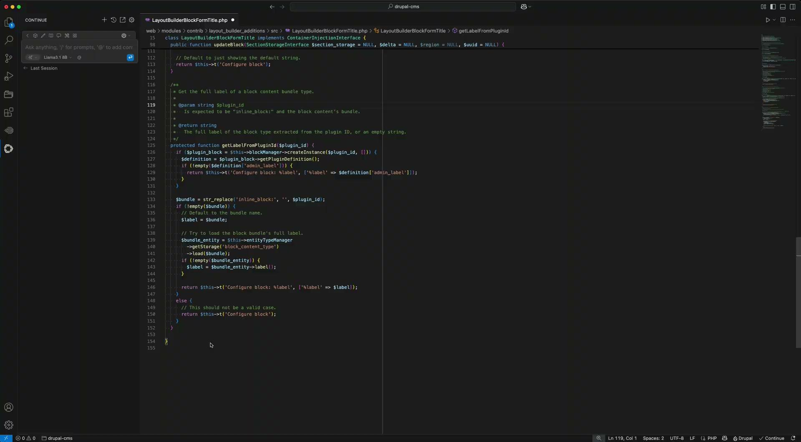
Demo: Code commenting
CONTINUE
Notes:
Demo: Code commenting

Slide 30
Cursor demo: Inline suggestions

Slide 31
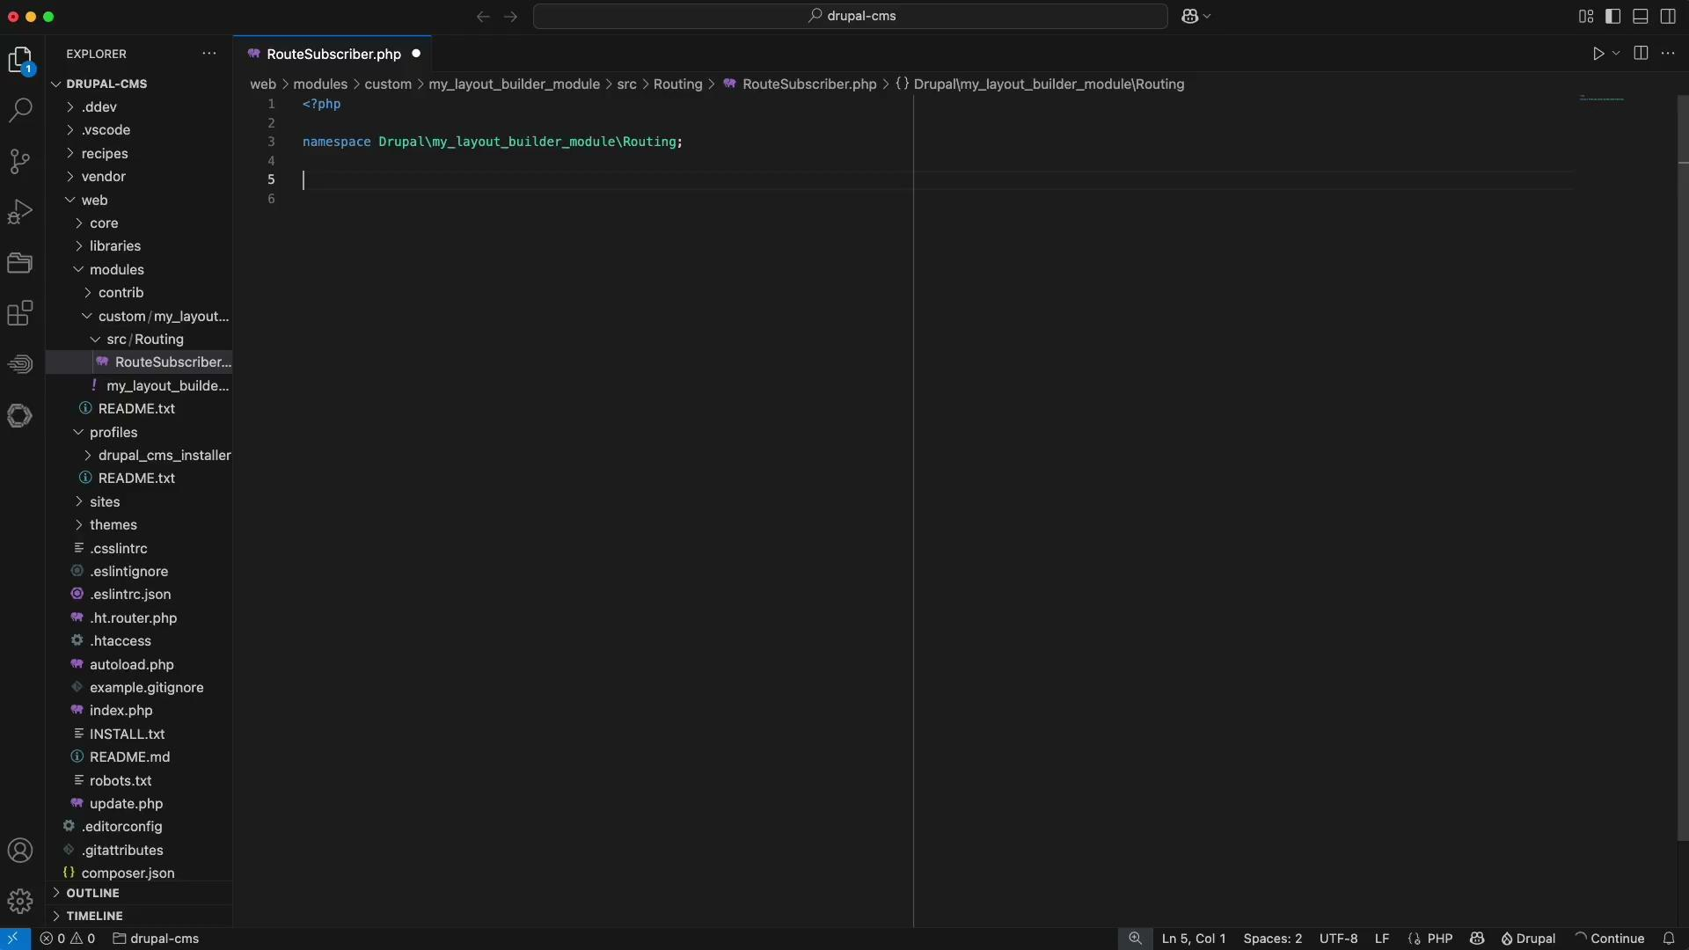
Demo: Inline suggestions
CONTINUE
Notes:
Demo: Inline suggestions

Slide 32
Cursor demo: Generate code

Slide 33
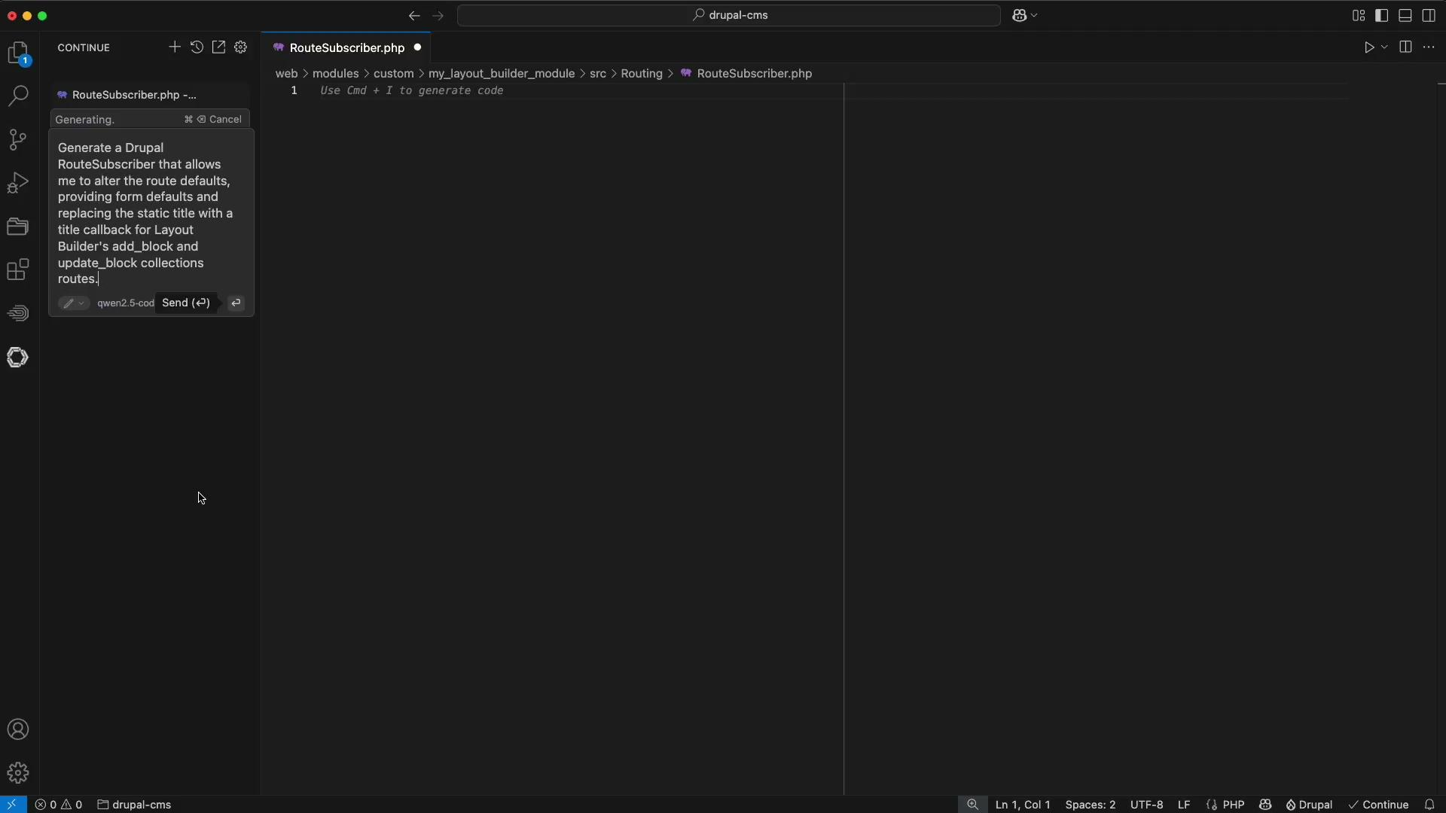
Demo: Generate code
CONTINUE
Notes:
Demo: Generate code

Slide 34

Cline
CONTINUE
Cline, formerly named ClaudeDev, is another open-source coding assistant.
It can be explored as an alternative, but it also has different strengths compared to Continue.
Continue focuses on doing a great job of auto-completing code.
Cline focuses on idea generation and complex tasks.
They’re not mutually exclusive.

Slide 35
Have you heard of Cursor?
CONTINUE
Cursor is essentially a fork of VSCode that provides AI capabilities, requiring a subscription for a certain amount of usage.
Open-source solution
Open-source, non-subscription alternative: VSCode + Continue + Cline
Gives very similar features and functionality to Cursor
Cline also supports prompt caching (when used with Claude) and much broader model customization (you can integrate it with Ollama)

Slide 36

The Future
05
Notes:
Drupal AI has rapidly improved.
Dries’ fireside chat yesterday.
Excited about AI search, since a lot of clients ask about Natural Language Processing.
Last week, Olama released a new engine in 0.7.0 to support multimodal models.
An example of this is being able to ask location-based questions about a video frame. You can then ask follow-up questions based on the responses.

Slide 37



Questions
06
Notes:
Placeholder, should add new title slide to match the other section slides

Slide 38

CONTRIBUTION DAY
Thursday 10:00am to 4:00pm
You don't have to know code to give back!
New Contributor training 9:00am to 10:00am

Slide 39

Thank you!

